Slide 1

Leading Global Provider of
Supply Chain Management Solutions
NASDAQ: AMSWA
Allan Dow
CEO
Vincent Klinges
Chief Financial Officer
June 2020

Slide 2
Forward Looking Statements
This presentation may include statements that may constitute “forward-looking statements,” including estimates of future business prospects or financial results and statements containing the words “believe,” “expect,” or similar expressions. Any forward-looking statements herein are made pursuant to the safe harbor provision of the Private Securities Litigation Reform Act of 1995. There are many factors that could cause actual results of American Software to differ materially from those anticipated by forward-looking statements made herein. These factors include continuing economic uncertainty, the timing and degree of business recovery, unpredictability and the irregular pattern of future revenues, competitive pressures, delays and other risks associated with new product development, the unpredictability of the effectiveness and duration of third-party marketing agreements, undetected software errors, and risks associated with market acceptance of the Company’s products and services as well as a number of other risk factors that could affect the future performance of the Company. Please refer to a discussion of these factors and others in the Company's most recent Annual Report on Form 10-K and in its Quarterly Reports on Form 10-Q and other reports and documents subsequently filed with the Securities and Exchange Commission. For more information about risks the Company could face as well as other information, contact Vincent C. Klinges, Chief Financial Officer, American Software, Inc., 470 East Paces Ferry Rd., Atlanta, GA 30305, (800) 726-2946 or (404) 264-5477. FAX: (404) 264-5206 INTERNET: www.amsoftware.com or E-mail: ask@amsoftware.com.

Slide 3
Investment Highlights
Supply Chain Software Leader | Multi-Brand Strategy
Innovative Technology | SaaS Transition
Strong Financial Position | Disciplined Capital Allocation

Slide 4
Company Overview
NASDAQ: AMSWA

Slide 5







Supply Chain Software Overview
48+ Years as a Best-of-Breed Provider of Supply Chain and Retail Optimization Solutions
1,000+ Customers in over 80 Countries Attracted by
Vertically Oriented Solutions and Functional Depth
Multi-Brand Strategy Addresses Needs of Global 1000, Enterprise and SMB Companies
Proven Results and Track Record of Innovation
Notes:
Allan
We’ve … (highlight 1, 2 and that we serve all markets with a single solution)
… and we’ve been investing for the future.

Slide 6
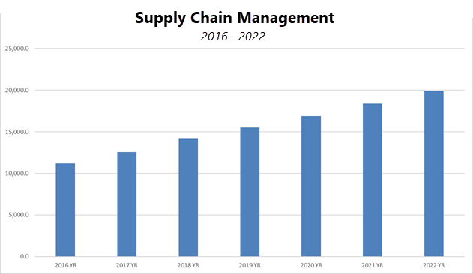

Supply Chain Management Growth
Market Forecast 2016 to 2022
The Supply Chain Management (SCM) market will exceed $15 billion in total software revenue by 2019 and reach nearly $20 billion by 2022.
This represents a CAGR of 9.7% through 2022.
Notes:
Really exciting news that we are in a growing market.

Slide 7
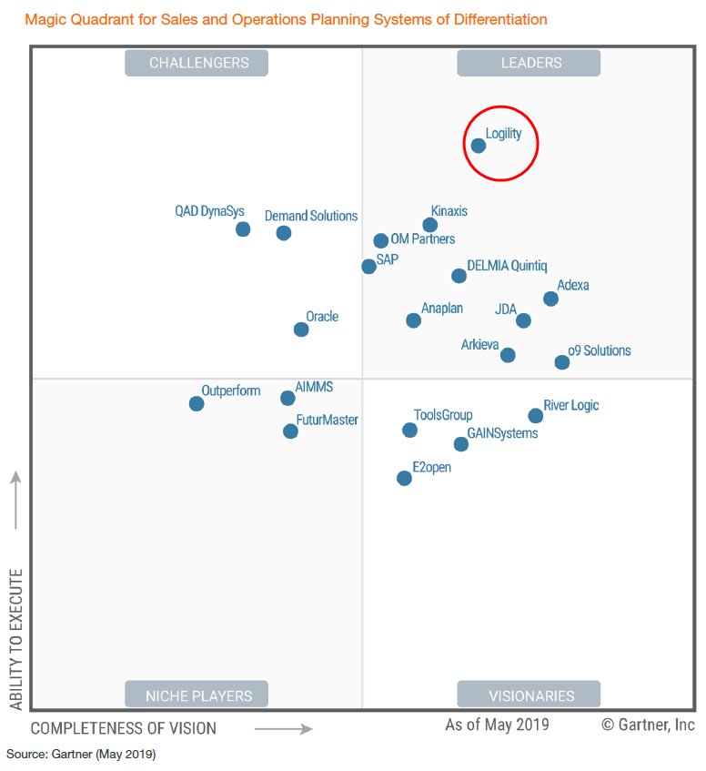
Logility: 2019 Gartner S&OP Magic Quadrant
“Logility has a good understanding of the direction of the S&OP market. Its vision for a digital supply chain twin, the use of continuous planning and advanced analytics/AI is above average.”
“[Logility’s] reference customers reported above-average overall satisfaction levels with a strong likelihood to select Logility again. They also reported above-average
satisfaction with the level of business benefits achieved.”
Tim Payne, Research Vice President
S&OP Magic Quadrant, May 2019

Slide 8
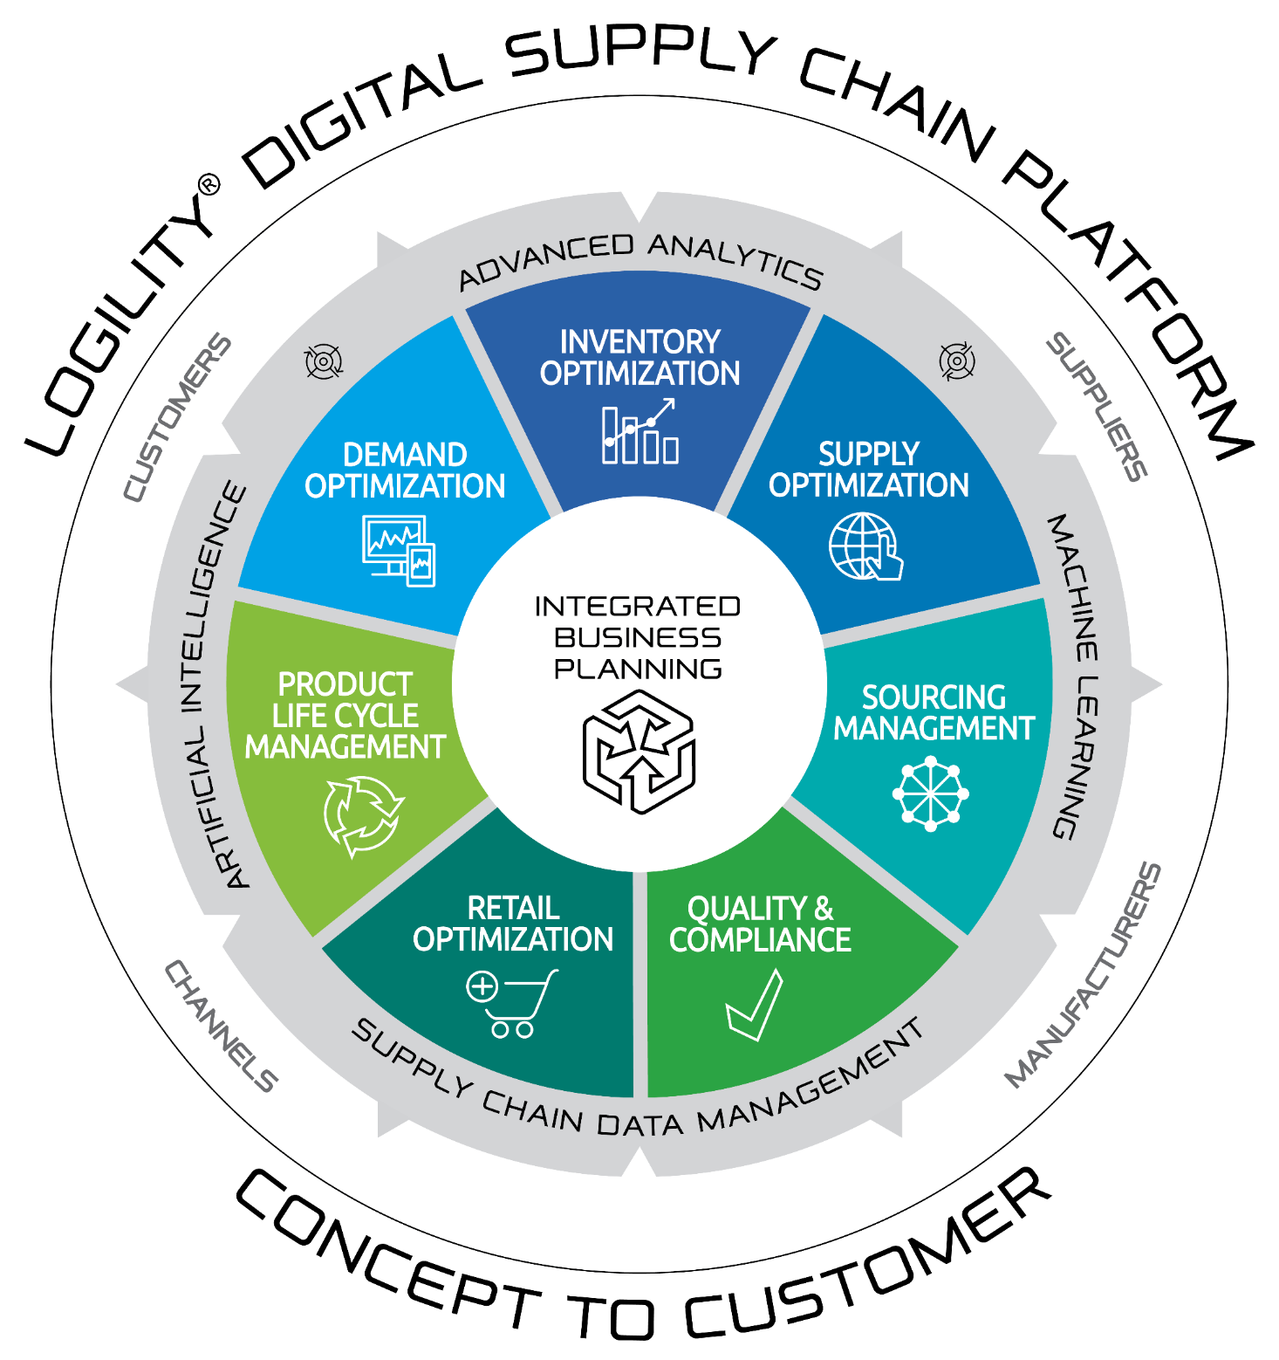
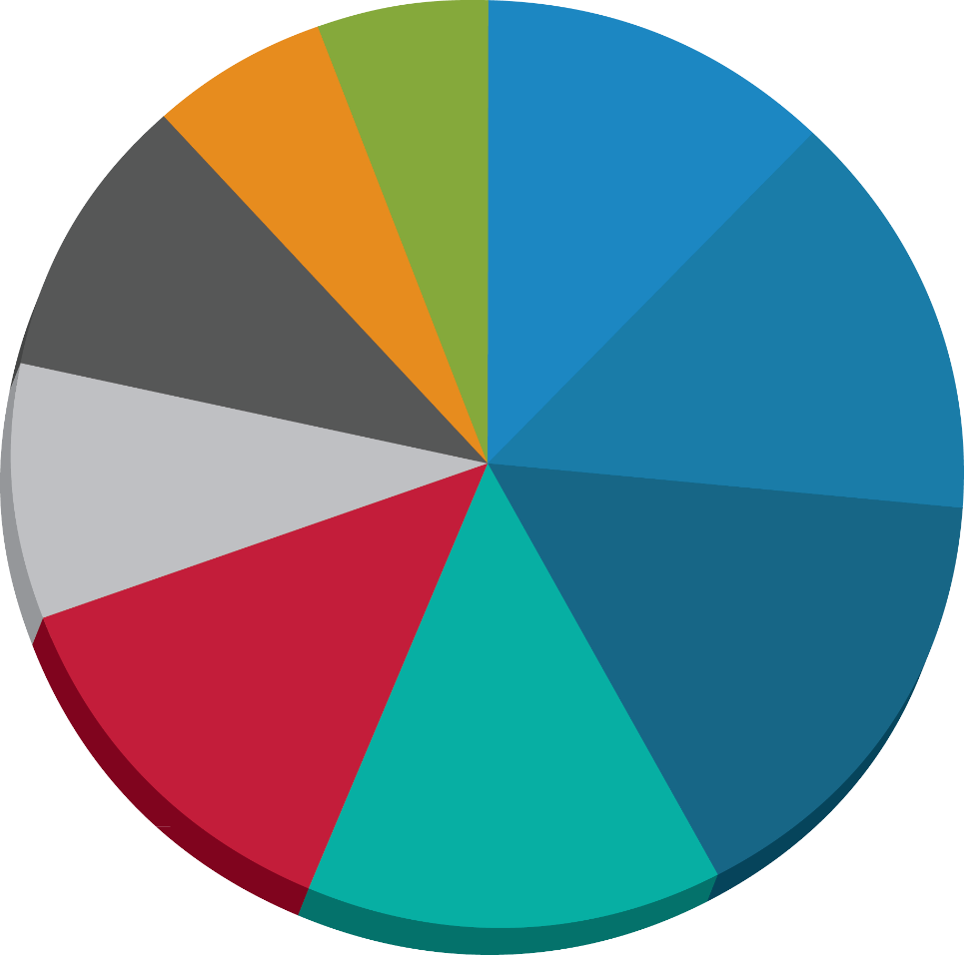
Digital Supply Chain Platform & Industry Verticals
SCM Customer Base
Service/Aftermarket
Life Sciences
6%
Apparel and Footwear
6%
12%
Chemical/Process
Food and
Beverage
10%
Total
Consumer
Products
42%
14%
Wholesale
Distribution
9%
16%
13%
Other
Consumer
Goods
14%
Retail
Durable Goods

Slide 9




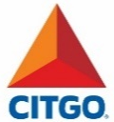

















































Diversified Customer Base
Softgoods/
Apparel
Durable Goods/
Service Parts
Retail
Life Sciences
Process/Chemical
Consumer Goods

Slide 10










Forces Redefining Supply Chain and Business Planning
Global Market Dynamics
Convergence of Planning & Execution
Cloud Computing
Talent Wars
Real-time Insights
Digital Twin
Digital Natives
Analytics Imperative
Resiliency
Speed & Agility
Notes:
Allan
Today we operate in a world of ever increasing complexity. We are in a 24x7x365 connected world with an information explosion where the amount of data is doubling every 18 months. Some of that data is structured (like sales or product information) and some of it is unstructured (like customer sentiment, …).
Furthermore, the pressure of the INFORMED customer and the new Omni-channel challenges accelerate and add complexity to your supply chain. There’s a wealth of knowledge that can be extracted from social media that provides insight from customer sentiment.
At the same time we are experiencing a shortage of skilled supply chain talent. The planners of today think differently, want to engage differently, and expect a new role and new experiences in your organization within a few years.
And the speed at which supply chains operate is going faster every day. The number of new product introduction is accelerating. You are facing time to market compression.
We need to help you transform your operations!

Slide 11

THE 10X JOURNEY
Automation through Artificial Intelligence
Data Management Strategy
Organize for Agility
Notes:
If you are going to be successful in the speed driven transformation you have to do 3 things:
Automate by leveraging Artificial Intelligence
Implement a Master Data Management Strategy
Organize for Agility

Slide 12
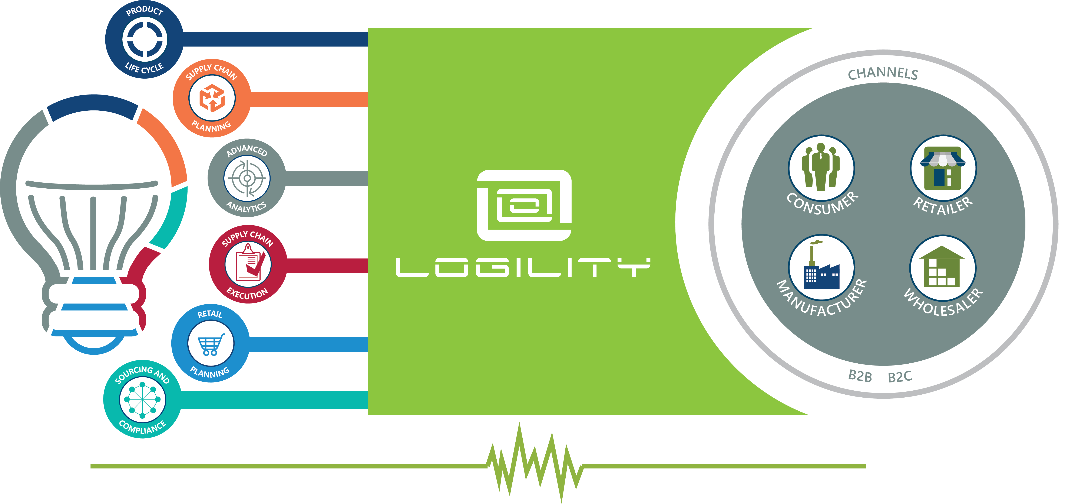


Powering the Digital Supply Chain from Concept to Customer
Notes:
We are creating the solution to help you achieve your 10 x goal. Today we deliver the only Digital Supply Chain platform that will allow you to manage the entire planning process from product Concept to Customer availability. This stems from the cumulative efforts across our brands to bring together a single platform for Network Orchestration.

Slide 13
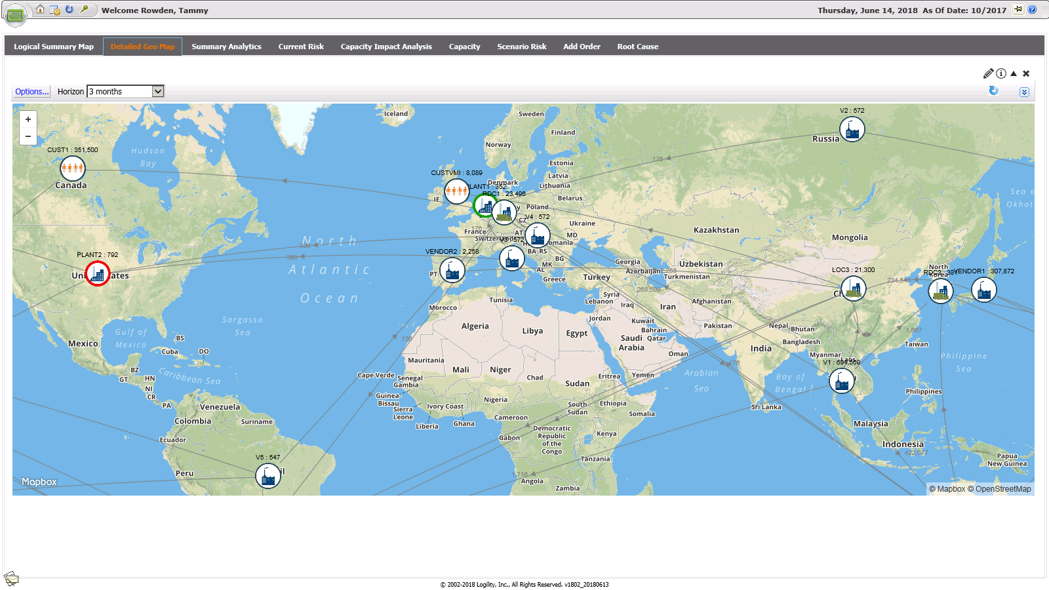





Supply Chain Digital Twin for Continuous Planning
Notes:
The next phase is to move to continuous planning with visual cues regarding opportunities or risks with an easy workflow to act on that information.
Once properly aligned, the digital model will provide event driven scenarios derived by the system and presented to the analysts in a way that allows them to quickly make value based decisions that align to your corporate strategy or culture. For example, if demand exceeds supply, how do you want to respond to this opportunity? Do you have priority customers that must be served? Are there more profitable segments that you will serve first or will all channels be trimmed equally? Your analysts are presented with sufficient information to make that call and take action to respond appropriately.

Slide 14
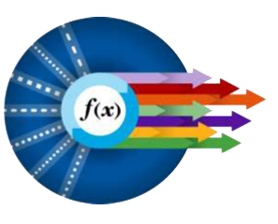

Automating Planning and Decision Support
Non-optional
Automation
Automation that can be Over-ridden
Take responsibility for this task and don’t let me or anyone else interfere
Opt-In
Automation
Automatic Reorder Points for Replenishment
Advisory
Guidance
Try Multiple Forecasting Models and recommend the best fit
Specific
Information
Automated Alerts (Planning Systems, Production Equipment)
General
Information
Statistical Forecasting
Use of historical data (sales, production, etc.)
Source: Gartner 2017
Notes:
As your processes mature and you build comfort, you can adopt more automation and ultimately drive towards non optional automation eliminating human intervention. This move is necessary for you to evolve to Network Orchestration and become market leaders based on consumer centric demand – understanding individuals current buying preferences even if the consumer is not your direct customer.
We must build solutions that we trust to perform autonomously, removing steps and speeding time to market.
The day is coming when spreadsheets will become as archaic as the type writer. The transition from S&OP to Continuous Autonomous Planning will be a lot of work. But the prize is huge!

Slide 15

Our Transformation
FROM SOFTWARE TO SERVICE PROVIDER
Notes:
20 years ago when I joined the company we were a software company. The expectation was to build great software, help our customers implement and leave them alone.
Today we are a cloud company, lifting the challenges of day to day administration and augmenting their staff with robust services to allow for secure and continuous operations.
Tomorrow we will be a service provider – where we administer the solutions that manage the customers supply chain. In doing so they will gain the insights and decide on the strategy – we will manage to model parameters to achieve those objectives and the solution will execute the plan.
Again – this will not be business process outsourcing where we replace their supply chain staff with people on our payroll. The customers supply chain team will gain the insights and decide on the strategy – we will manage to model parameters to achieve those objectives and the solution will execute the plan relentlessly day in and day out across the entire supply chain without data latency or delays due to staff availability or time zone barriers.

Slide 16






Investing for the Future as of 1/31/20
ZERO
1,000+
$80+70M
Debt
Gross R&D Investment
5 Years past / 3 Years Ahead
Customers
In Over 80 Countries
$3B+
18
$96M
32 + 26%
$28M
Revenue to Date
Consistent Years of Profitability
Cash &
Investments
Staff Growth
5 Years past / 3 Years Ahead
Acquisition Investments
Over 8 Years

Slide 17



Our Brand
PROMISE
A partner to help transform our customers businesses with our industry expertise and solutions to realize value within the first 6 months and start an innovation journey that delivers a digital decision support platform to MAKE OUR CUSTOMERS MORE SUCCESSFUL YEAR AFTER YEAR.
Notes:
Recognized as the SCM Partner delivering the greatest value by:
- Prescriptive Industry PoV
- Agile Implementation – 80% value in 20 % time with built in Analytics to continuously measure customer value throughout the relationship lifecycle
Reduce the Implementation effort by 20% year over year through innovation on self learning systems and process improvement, reducing the time to value in ½ over the next 3 years
Building metrics into the deployment to have a continuous report card on progress to success
Transforming the supply chain by delivering a digital decision platform to allow customers realign resources for agile customer response vs siloed supply chain efficiency
We will break the mold and surpass the traditional waterfall implementation approaches of all the big 6 SI’s to become the VALUE PARTNER for supply chain transformation.

Slide 18
Financial Summary
NASDAQ: AMSWA

Slide 19
Revenue Contributions
Revenue by Segment ($MMs)

Slide 20
Transition to the Cloud

Slide 21
Rising Mix of Recurring Revenue
Quarterly Revenue in $MMs

Slide 22
Growing Subscription Revenue Stream
Subscription & Maintenance Revenue in $MMs

Slide 23
Gross Margin Expansion
Gross Profit in $MMs
Non-GAAP Subscription Gross Margin*
*Non-GAAP subscription gross profit and gross margin excludes amortization of capitalized software

Slide 24
Sustained Profitability Amidst Cloud Transition
Adjusted EBITDA in $MMs

Slide 25
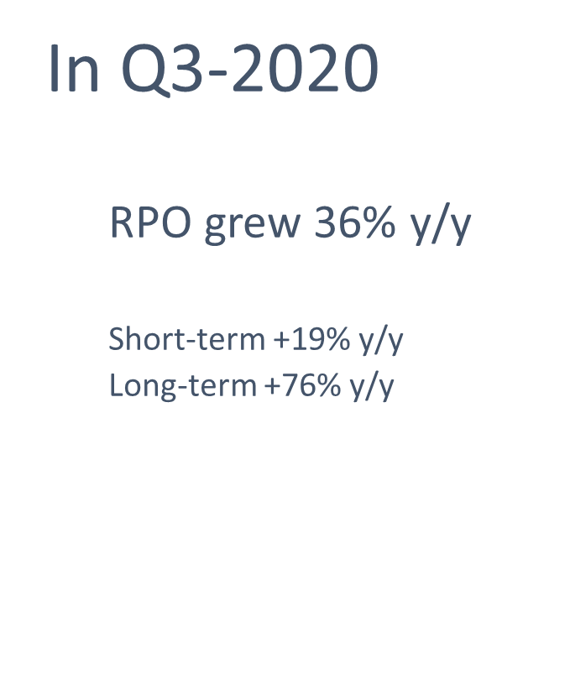
Improved Visibility from Backlog Growth
Remaining Performance Obligation (RPO) in $MMs

Slide 26
Current Valuation Metrics

Slide 27
NASDAQ: AMSWA
www.amsoftware.com
www.logility.com
www.demandsolutions.com
www.ngcsoftware.com

